Slide 1
Data Centric RAD
Bachelor of Science (Honours) in Computing in Software Development
Bachelor of Science in Computing in Software
Development
Department of Computer Science & Applied Physics

Slide 2
JSF – Java Server Faces
JSF (JavaServer Faces) is a server-side user interface (UI) component framework for Java technology-based web applications.
JSF is based on the MVC (Model View Controller) web framework that simplifies the construction of web applications in Java.

Slide 3
JSF
The main components of JSF are:
An API for representing UI components and managing their state; handling events, server-side validation, and data conversion; defining page navigation; supporting internationalization and accessibility; and providing extensibility for all these features
Two custom tag libraries for expressing UI components within a JSP page and for wiring components to server-side objects
h - This tag library contains JSF component tags for all UI Components defined in JSF
f - The core JavaServer Faces custom actions

Slide 4
Why JSF?
JSF is the Standard way of building web application UIs in Java – supported by Oracle.
JSF offers a clean separation between behaviour and presentation for web applications.
A JSF application can map HTTP requests to specific event handling components as on the server allowing you to build web applications that implement the finer-grained separation of behaviour and presentation that is traditionally offered by client-side UI architectures.
Large number of reusable UI components.
Extendable – Many 3rd party libraries such as OpenFaces and PrimeFaces have extra functionality.
Easy to process and validate form data.

Slide 5
JSF Components
A set of web pages to layout UI components.
A set of ManagedBeans.
A web deployment descriptor (web.xml).

Slide 6
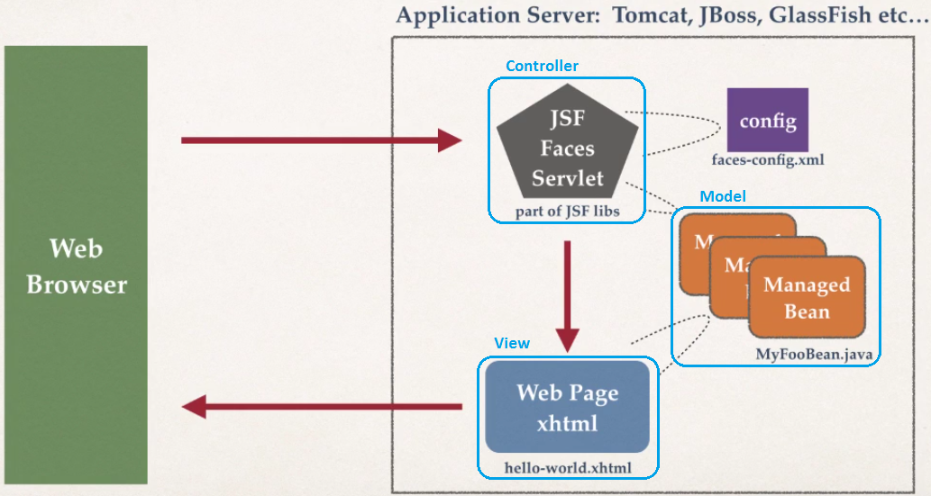
JSF Architecture

Slide 7
Application Server Support
Application Servers such as JBoss Wildfly 8 and Glassfish 4 have full JSF 2.2 support.
In Tomcat 9, the JSF libraries need to be added manually.

Slide 8
JSF Tags
JSF simplifies building UIs by using tags.
The h library contains all the JSF UI tags such as:
button
dataTable
form
inputText
To use the h library’s UI tags include a link to the xml namespace:
xmlns:h="http://xmlns.jcp.org/jsf/html"

Slide 9
JSF Tags
The f library contains general purpose tags for selection, conversion, validation, Ajax etc.
A Common f tag is f:selectItem which adds a select item component to a UI component, for example a Radio Button or a Drop down list.
The most frequently used attributes of selectItem are
itemValue – the reference to the item in the code
itemLabel – the text displayed to the user:
<f:selectItem itemValue="Red" itemLabel="Red" />
To use the f library’s UI tags include a link to the xml namespace:
xmlns:f="http://xmlns.jcp.org/jsf/core"

Slide 10
JSF Tags
JSF supports HTML5 by not introducing new UI components that duplicate HTML5 ones but by allowing you to use HTML5 markup directly.
For example, the HTML5 attribute placeholder is associated with an input element.
This attribute is not duplicated in JSF, but the placeholder attribute can still be used.

Slide 11
JSF Pass-Through Attributes
Pass-through attributes are not interpreted by JSF but are passed through to the browser where they are interpreted or rendered.
Pass-through attributes are defined using the following xml namespace:
xmlns:p=http://xmlns.jcp.org/jsf/passthrough

Slide 12
Using a JSF tag with a pass-through attribute
Define the UI and pass-through namespaces:
<html xmlns="http://www.w3.org/1999/xhtml"
xmlns:h="http://xmlns.jcp.org/jsf/html"
xmlns:p="http://xmlns.jcp.org/jsf/passthrough">
<h:inputText p:placeholder=“Enter your name”/>

Slide 13
JSF Tags - commandButton
h:commandButton renders an HTML element as follows:
<input type=“submit”
The action attribute of the h:commandButton can specify a page to navigate to (without the .xhtml extension):
<h:commandButton value="OK" action=“page2”>
</h:commandButton>

Slide 14
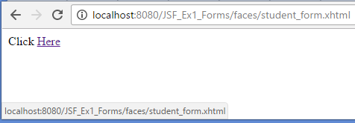
JSF Tags - outputLink
The h:outputLink tag renders an HTML a element.
The output attribute specifies the webpage to navigate to:
Click <h:outputLink value="student_form.xhtml">Here</h:outputLink>

Slide 15
JSF Tags - selectOneRadio
The h:selectOneRadio tag renders an HTML input element of type radio.
For example given the following Radio Button one of three possible values to select:
<h:selectOneRadio value="#{myColour}">
<f:selectItem itemValue="R" itemLabel="Red" />
<f:selectItem itemValue="G" itemLabel="Green" />
<f:selectItem itemValue="B" itemLabel="Blue" />
</h:selectOneRadio>
The value of myColour will be either R, G or B.

Slide 16

JSF Tags - selectOneMenu
The h:selectOneMenu tag renders an HTML select element.
For example given the following Radio Button one of three possible values to select:
<h:selectOneMenu value="#{myColour}">
<f:selectItem itemValue="R" itemLabel="Red"/>
<f:selectItem itemValue="G" itemLabel="Green"/>
<f:selectItem itemValue="B" itemLabel="Blue"/>
</h:selectOneMenu>
The value of myColour will be either R, G or B.

Slide 17
JSF Bindings
JSF uses Expression Language to manage variable bindings:
#{variable} gets or sets the value of variable
For example:
<h:inputText value=“#{name}” p:placeholder=“Enter your name”/>
Binds the value of what ever is input in the inputText to the variable name

Slide 18
JSF Bindings
name can then be displayed in another webpage by simply using the EL syntax:
#{name}

Slide 19
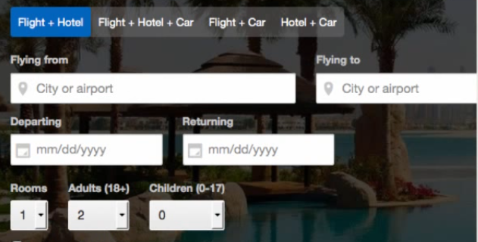
JSF Forms
JSF components will generate HTML forms
JSF UI Component | Description
h:form | Main Form Container
h:inputText | Text Field
h:inputTextArea | Multi-line Text Field
h:selectBooleanCheckBox | Check Box
h:selectOneRadio | Radio Buttons

Slide 20
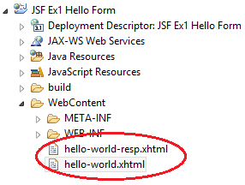
JSF Hello World Application
In JSF, web pages have the extension .xhtml
To run, right-click on web page and select Run As/Run on Server
All Web Pages are in WebContent Folder

Slide 21


hello-world.xhtml
<!DOCTYPE html>
<html xmlns="http://www.w3.org/1999/xhtml"
xmlns:h="http://xmlns.jcp.org/jsf/html"
xmlns:p="http://xmlns.jcp.org/jsf/passthrough">
<h:head>
<title>JSF Hello World Web App</title>
</h:head>
<h:body>
<h:form>
Name: <h:inputText value="#{name}" p:placeholder="Enter your name"/>
<h:commandButton value="OK" action="hello-world-resp“/>
</h:form>
</h:body>
</html>

Slide 22

hello-world-resp.xhtml
<!DOCTYPE html>
<html xmlns="http://www.w3.org/1999/xhtml"
xmlns:h="http://xmlns.jcp.org/jsf/html">
<h:head>
<title>JSF Hello World Web App - Response Page</title>
</h:head>
<h:body>
Hello World from #{name}
</h:body>
</html>

Slide 23
JSF & ManagedBeans
A ManagedBean is normal Java Class.
It is used to hold form data and implement business logic.
The ManagedBean (Java Class) is created and managed by JSF – it does not have to be created by your code.

Slide 24
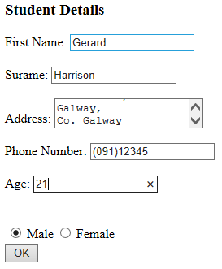
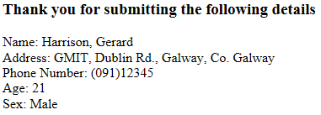
JSF without ManagedBeans
Input.xhtml
Output.xhtml

Slide 25
JSF with ManagedBeans
Input.xhtml
Output.xhtml
ManagedBean
Student

Slide 26
ManagedBean Requirements
Must have a Public no argument Constructor
Must expose properties via Public getter/setter methods
Must have the @ManagedBean annotation (import javax.faces.bean.ManagedBean)

Slide 27
ManagedBean Example
import javax.faces.bean.ManagedBean;
@ManagedBean
public class Student {
private String firstName;
private String surname;
public Student() {
}
public String getSurname() {
return surname;
}
public void setFirstName(String firstName) {
this.firstName = firstName;
}
public String getSurname() {
return surname;
}
public void setSurname(String surname) {
this.surname = surname;
}
}
@ManagedBean annotation
Public no argument
Constructor
Public getters/setters

Slide 28
Reading data from a ManagedBean
Previously we saw how to bind data to a variable:
#{variable}
This will either read the value of variable or if used in an input element, set the value of variable:
<h:inputText value="#{firstName}"

Slide 29
Reading data from a ManagedBean
A similar syntax is used to get data or set data in a ManagedBean:
Name is: #{student.firstName}
This will automatically call Student.getFirstName() and display the return value.
Enter Name: <h:inputText value="#{student.firstName}"
This will automatically call Student.setFirstName(name) with whatever was entered in the input field.

Slide 30
Displaying a ManagedBean property
Name is: #{student.firstName}
public class Student {
When a ManagedBean property is being displayed, the first letter of the property is capitalised and get inserted before it to get the Class method to call
First letter of the ManagedBean
is the lowercase first letter of Class Name
private String firstName;
public String getFirstName() {
return firstName;
}

Slide 31
Setting a ManagedBean property
<h:inputText value="#{student.firstName}"
public class Student {
When a ManagedBean property is being displayed, the first letter of the property is capitalised and set inserted before it to get the Class method to call
First letter of the ManagedBean
is the lowercase first letter of Class Name
private String firstName;
public String setFirstName(firstName) {
this.firstName = firstName;
}

